Slide 1
Mobile RESTAURANT LOCATOR
Walter Hernandez

Slide 2
Introduction & ux dESIGN
The purpose of this design project is to develop a modern restaurant locator application. The software will have innovative featured to make locating simple. The users will be able to search by address, coordinates, and nearest locations. It will also have in depth filtering options. Filtering by price, distance, and foods will be a few of the options. All the restaurants will have a quick synopsis. When the users expands the restaurant selection, a further informative and full screen window will appear. Of course, ads will be a part of the experience. The ads feature will be geared towards the user’s satisfaction. The colors scheme and outlines must grab the user’s attention. A wonderfully crafted user experience will be developed to retain previous visitors. The process for the development will follow an organized structure.
The first step is to conduct contextual research to dive into the restaurant applications scene. Ideas will be noted, and trends surveys will be conducted. UI and UX pros and cons will be developed as the research is conducted. The second step is to conduct a professional briefing with stakeholders and the Project Team. The stakeholders will be the leaders invested into the project. In this case, John and Pam, investors in applications and software. Business, user requirements, and project reasoning will all be discussed. Once the briefing closes and agreements are made, then the design process begins. Benchmarks, workshops, and early usability testing will be conducted.

Slide 3
Introduction & ux dESIGN
The process for the development will follow an organized structure. The first step is to conduct research to dive into the restaurant applications scene. Ideas will be noted, and trends surveys will be conducted. UI and UX pros and cons will be developed as the research is conducted. The second step is to conduct a professional briefing with stakeholders and the Project Team. The stakeholders will be the leaders invested into the project. In this case, John and Pam, investors in applications and software. Business, user requirements, and project reasoning will all be discussed. Once the briefing closes and agreements are made, then the design process begins. Benchmarks, workshops, and early usability testing will be conducted.
User analytics will also be considered and dove upon. These analytics will be used to form persona profiles. We will also be consulting with a professional software developers during the process for their expert opinion. Other task models and deliverables will be developed. These includes sketches, wireframes and comprehensive use-cases. Once the project has numerous components, a protype will be developed with front, and back-end testing. Further analytics and research will be conducted based on the prototype. Once a final briefing and further ideas have been integrated, a final testing will begin. The final test will include live users. After the final test and any final modifications are made, the Stakeholders and the project team can initiate the application deployment.

Slide 4
Platform
The primary choice for the platform is a mobile format. Mobile formats have become the primary choice for many users on the go. The platform is more likely to attract modern users in respects to its portability. It features a user-friendly interface with touch screen functions. Users can use the applications from anywhere and are able to find restaurants while on the go.
Cell phones can also function to pinpoint the user’s location. The location feature will function as an ease of access form to locate restaurants nearby. As opposed to a web applications, mobile formats care limited to what the users can see. Therefore, a careful decision must be made on what the User Interface features. The Interface must have easy to read text and easy to navigate pages. Unlike a web application, further research will be conducted to narrow down the interface user prefer.

Slide 5
Platforms Differentiation
Alternate Suggestions
Both web and mobile applications are similar in the development process. They both require research to develop user functions. Mobile however, can be downloaded through a primary mobile store. Users can quickly load the applications and search for a potential restaurant. They can quickly sort by their wanted cuisine and decide. They are also often faster and have a higher attraction and retention capability. A web application can offer higher accessibility. Users have further options to choose from, and more branch decisions can be derived from the homepage. Also, a web application requires less modifications and adjustments so that it works on many devices. Mobile applications requires tweaking and in-depth development so that it works for Apple, Microsoft, Android and many other Mobile devices. Locating a restaurant on through the web often requires the users to have more time on their hands.
As an alternative, if a web application was to be developed, more categories and tabs can be useful to users. Each page would carry more information with reviews, photos, and menus. It would also be geared towards further accessibility for users with who need bolder or different color texts. The full screen feature would also function better in web. The adds will also be better sized in a web application. The user experience can be better handled. The sorting options can be further intricate and engaging. Web is traditional; therefore, a smaller learning curve is required to develop a restaurant locator applications.

Slide 6
Deliverables
Part of the design process, will require deliverables for the purpose of visualizations and idea sharing. A Persona Layout, Wireframe, and a Use-Case will be utilized. A Persona Layout functions as a theoretical user searching for a place to eat. They the persona is a false person who would be interest in a restaurant locator application. The Wireframe functions as a visual for the application. It is what a page would appear as in a cell phone. It serves so that the developers can quickly share and edit ideas. It is a photographic form a prototype. The use-case will serve as a programming visual. It is a diagram with the user and the actions they will perform through the restaurant locator application.

Slide 7
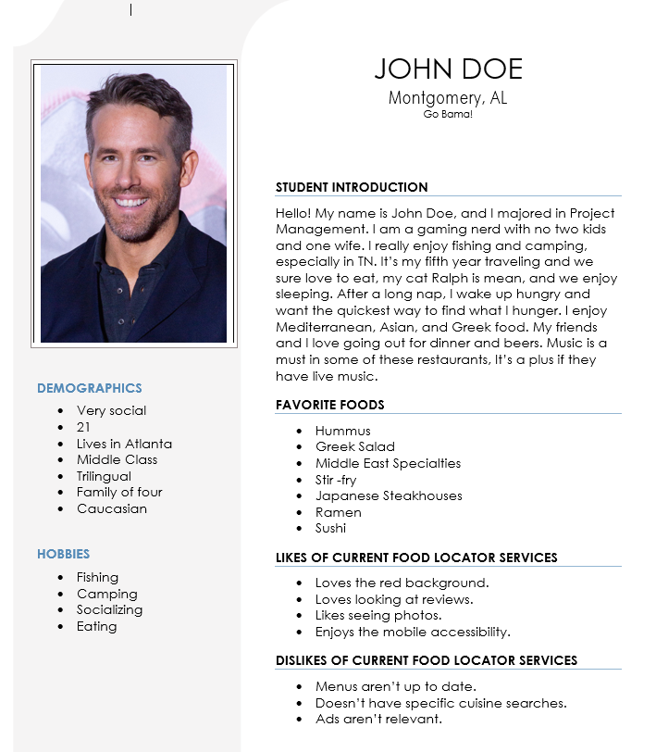
Persona Profile

Slide 8
Wireframes
Sorted Search
Full screen selection
Unsorted Search

Slide 9
Use-case

Slide 10
Conclusion
Once all testing is complete for the prototype, the launch of the application will undergo further testing. The process utilized in this project ensures quality and a thorough thought process. The research performed serves to better help the customers. Not only is the research useful, hut it also keeps the project with future trends and potential changes in the food or application industry. The deliverable serve to make the development simpler. Having a structured and unified helps to keep the team focused. The choice of developing a mobile restaurant locator fits the business goals and future. Other alternatives were also mentioned in the case that the investors want to develop a web application.

